Slide 1
Employee Payroll Management System
Presented By:
213 Java SL WQ(Group-2)

Slide 2
PROJECT MEMBERS
Amulya Shree N M 2485717
Ankireddipalli Vivekanandareddy 2484889
Ankit Kumar 2485037 (Team Lead)
Ankita Chandrakant Patil 2486974 (Frontend Lead)
Ankitha A Jain 2485062
Arcot Hemanth Rayan 2487047
Ankit Kumar 2484992
Arvind X 2485213
Balaji Venkatesh 2485706
Batta Mahendra Chowdary 2486659 (Backend Lead)

Slide 3
CONTENTS
Introduction
Background Of Project
Project Flow
Technology Used
Scope And System Overview
Modules Of Employee Payroll Management System
Functional Testing
Output Screenshots
Features & Advantages
Conclusion

Slide 4
INTRODUCTION
Employee payroll management system is an Internet-based Java application that automates the working of a company or work centre that manage and maintain records of the employees in the different department.
The objective of the Employee payroll management system project is to design a scheduling system for a work centre.
Scheduling is such a tool with which the process of intimating activities and notifications will be easy and even online in the organization where it is installed.

Slide 5
Background Of Project
Employee payroll management system is an Internet-based Java application that automates the working of a company or work centre that manage and maintain records of the employees in the different department. The objective of the Employee payroll management system project is to design a scheduling system for a work centre. Scheduling is such a tool with which the process of intimating activities and notifications will be easy and even online in the organization where it is installed. But these tasks of scheduling the different activities if manually done whether they may be personal, or official is time-consuming and may lead to confusion if not properly scheduled. The supervisor holds the various activities like sending notifications, mark attendance, and deleting the employees, and on the other hand employees view their details, view schedule or the notifications or any message form supervisor, and view attendance.

Slide 6
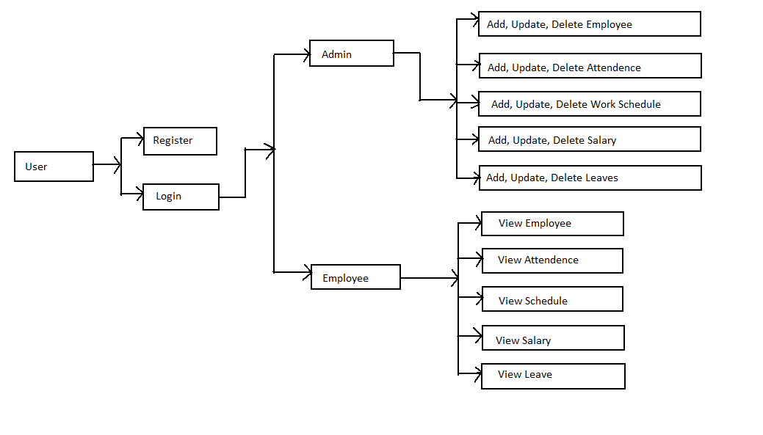
PROJECT FLOW

Slide 7
TECHNOLOGY USED
OPERATING SYSTEM : Windows 10
FRONT END : Html, CSS, Type script(Angular)
SERVER SIDE SCRIPT : Apache tomcat 9
DATABASE : MySQL
TESTING : Postman/Insomnia
BACKEND : Spring Boot

Slide 8
Scope and System Overview
Scope:
This Application works in Multiple PC’s installed on multiple Computers but sharing same database by which users of different department can use it sitting at different locations simultaneously.
But in future we can make the Application where the database will be hosted in order to manage the all departments which will be located in different places and by keeping domain of Application as Online.
System Overview :
The “Employee Payroll Management System” should support basic functionalities for all below listed users.
Admin
Employee

Slide 9
ADMIN MODULE
Login to Portal.
Add/Edit/delete the employees.
Add/Edit/delete the schedule the work of the employees.
Add/Edit/delete mark the attendance of employees.
Add/Edit/delete Leaves and timesheet of the employee.
Add/Edit/Delete the Salary of the employee.

Slide 10
EMPLOYEE MODULE
Each User must have a valid user id and password must be running for the system to function users must login in to system to access any record.
Register into the application.
Sign into the application to maintain the record of activities.
View his/her schedule set by Admin.
View his/her attendance.
Update his/her details.
View Salary.
View Salary Slip

Slide 11
Functional Testing
Verify that for new employee based on the user id of the employee, their records are added in the database.
Verify That Update Employee, Work Schedule, Salary, Leave is working.

Slide 12
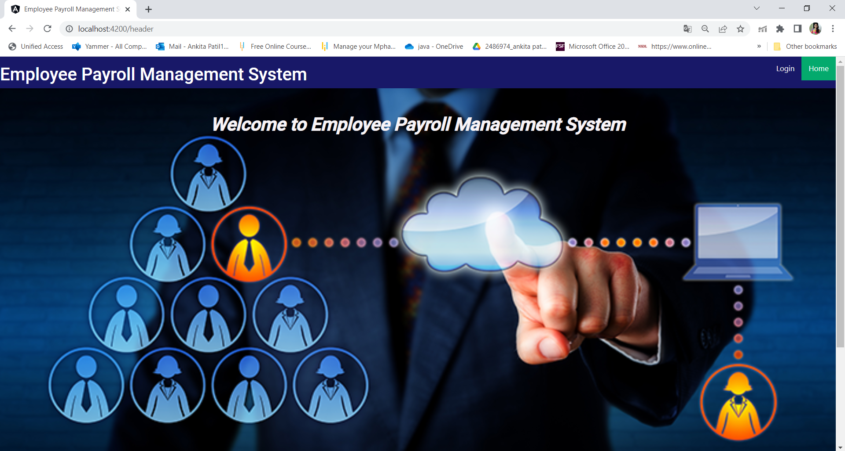
Output Screenshots

Slide 13
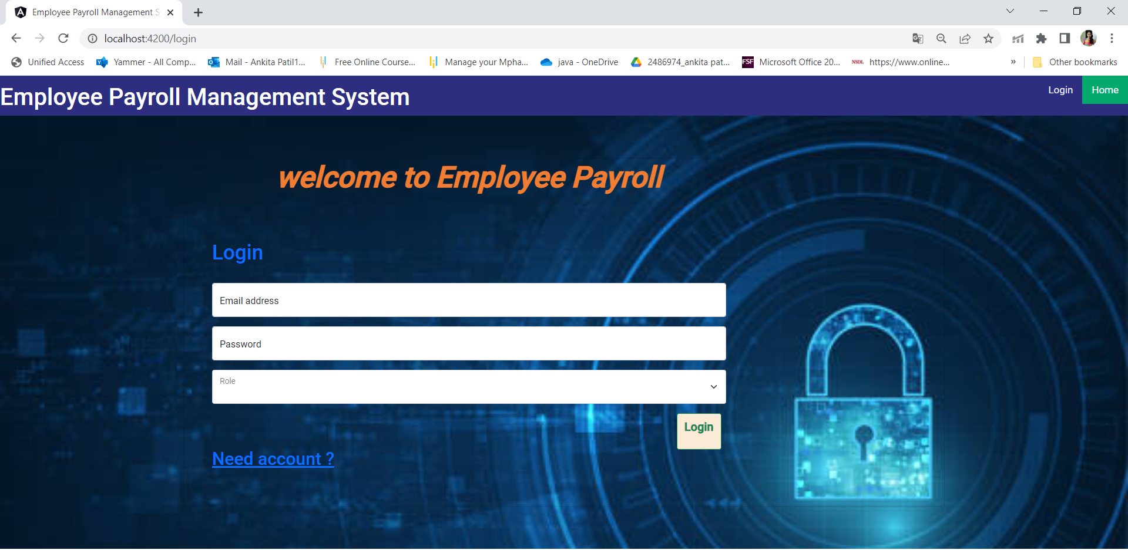
Login Page

Slide 14
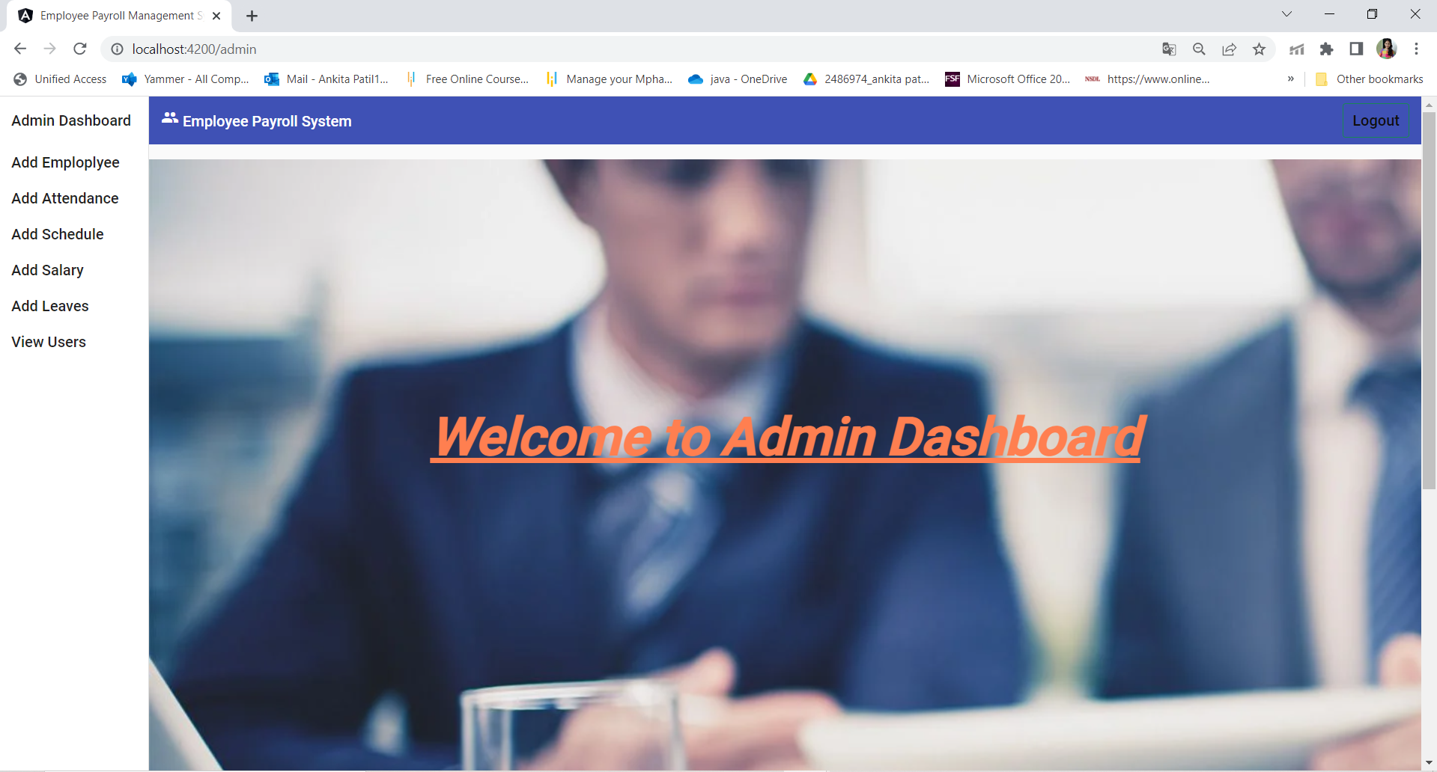
Admin Dashboard

Slide 15
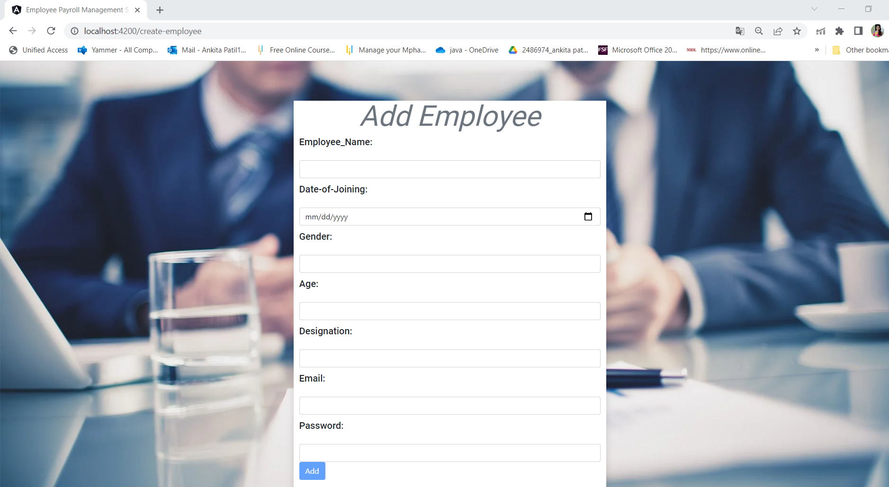
Add Employee

Slide 16
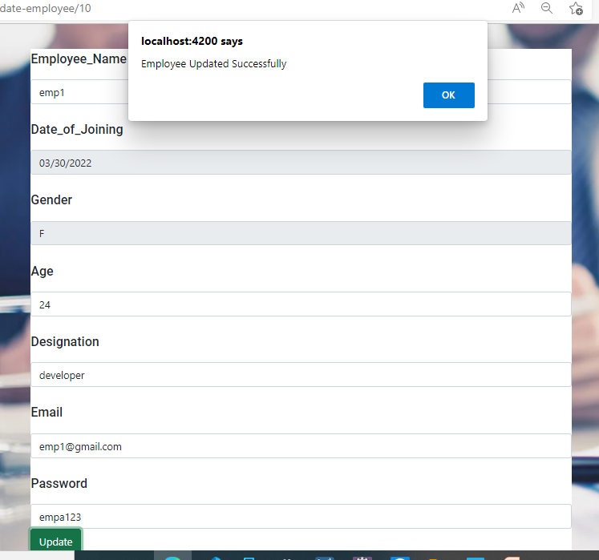
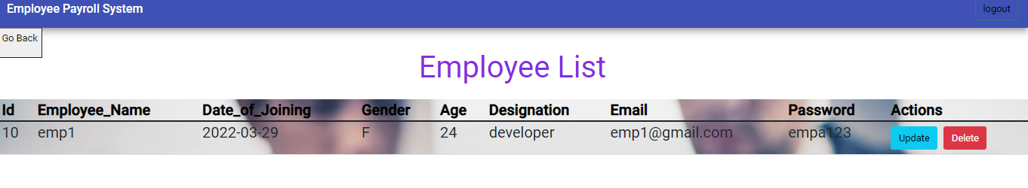
Update Employee

Slide 17
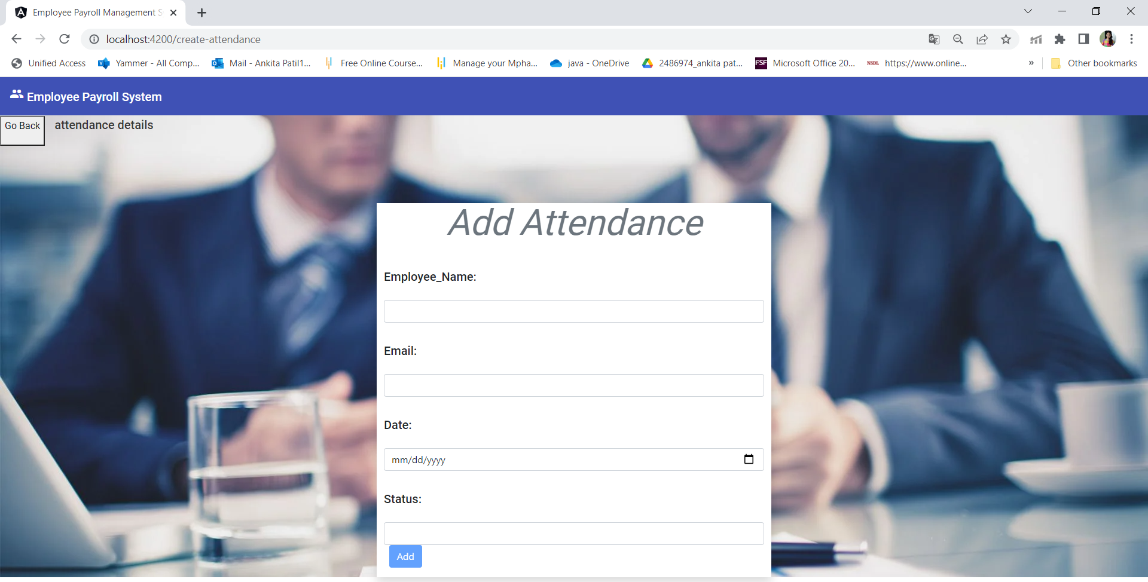
Add Attendance

Slide 18
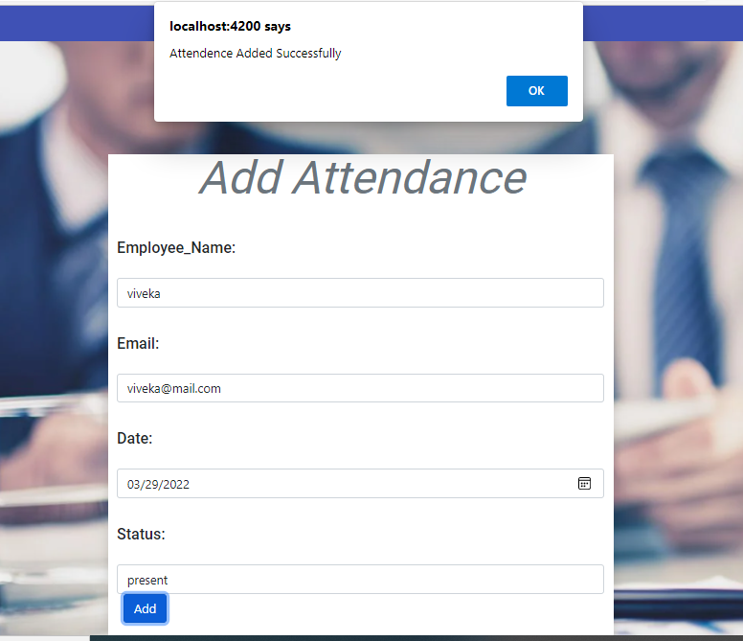
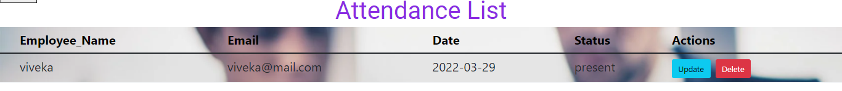
Update Attendance

Slide 19
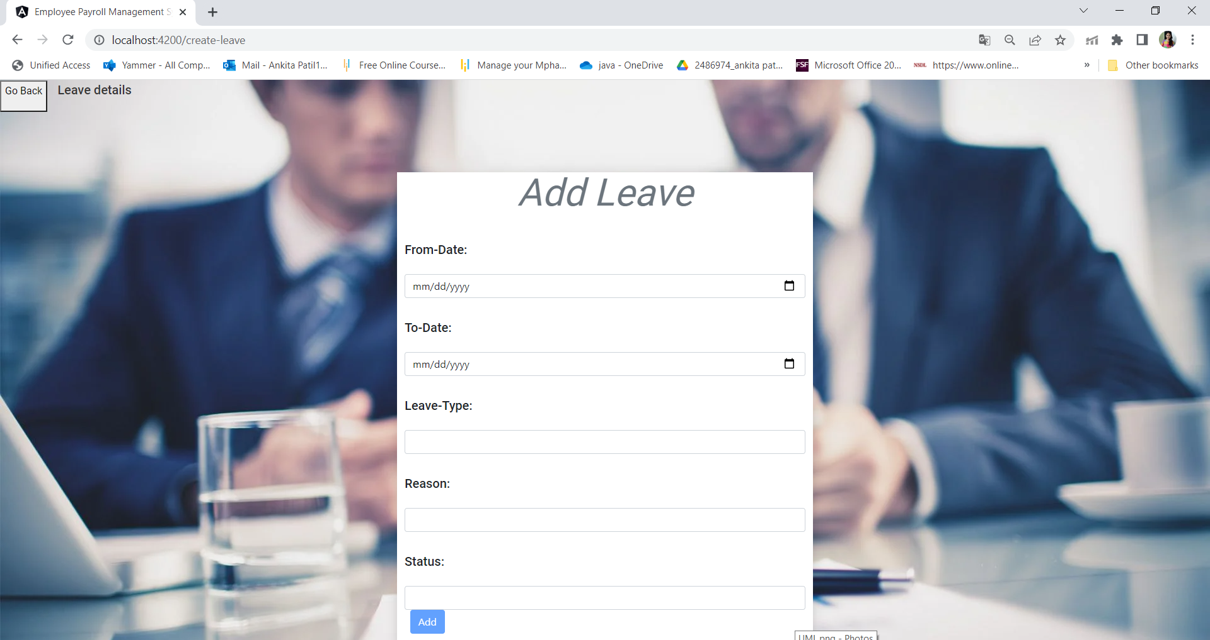
Add Leave

Slide 20
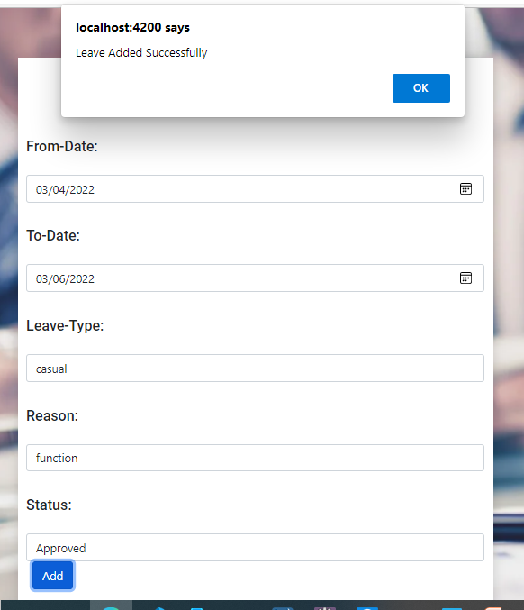
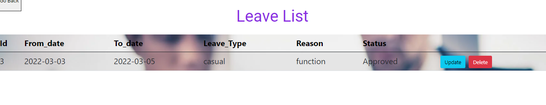
Update Leave

Slide 21
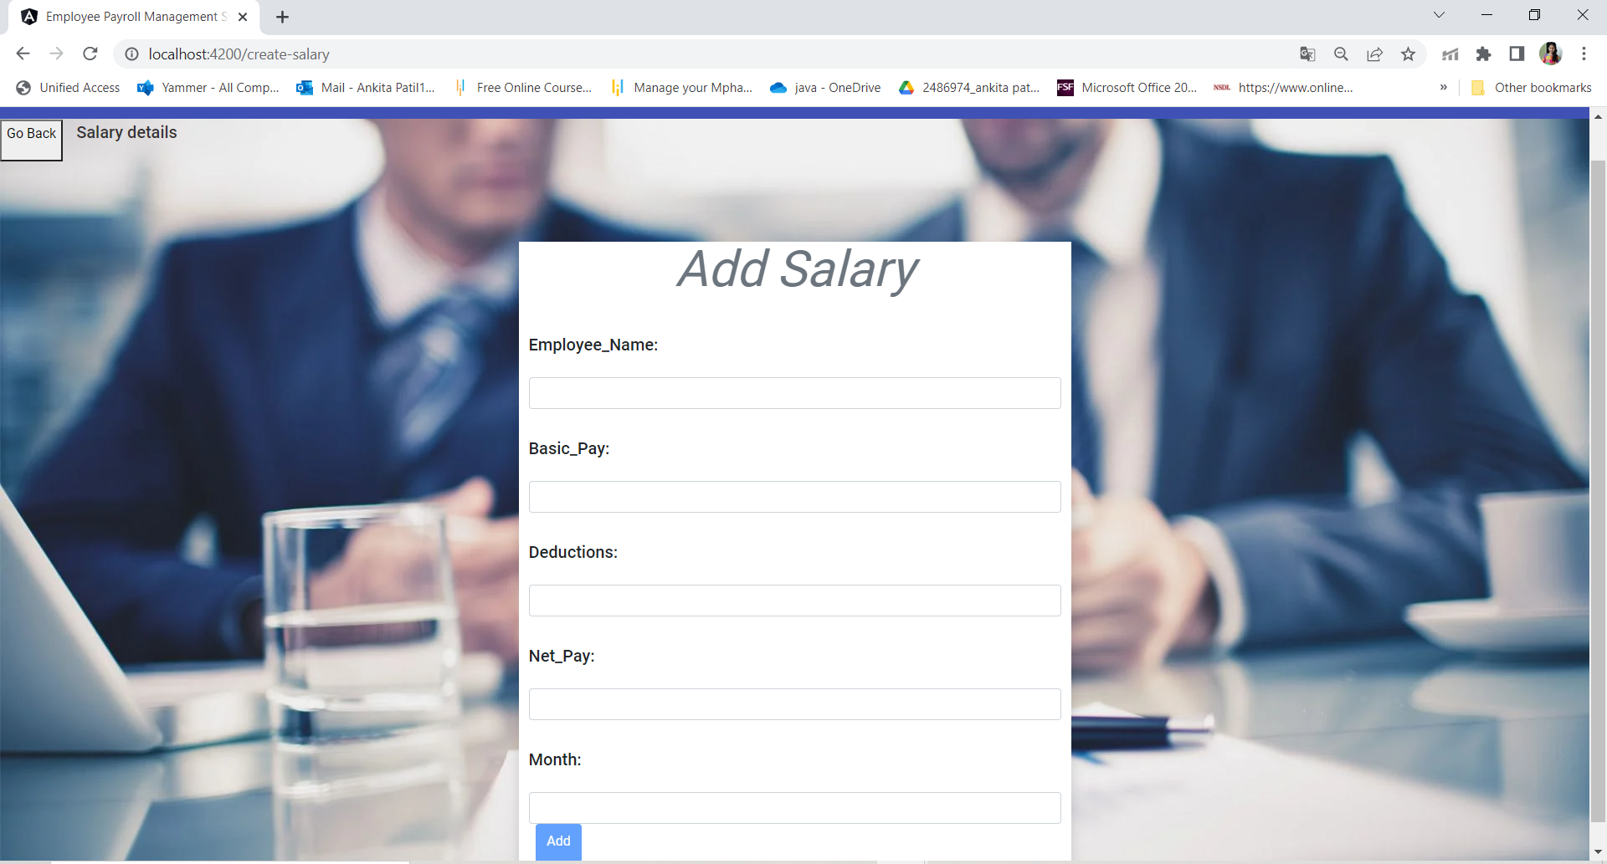
Add Salary

Slide 22
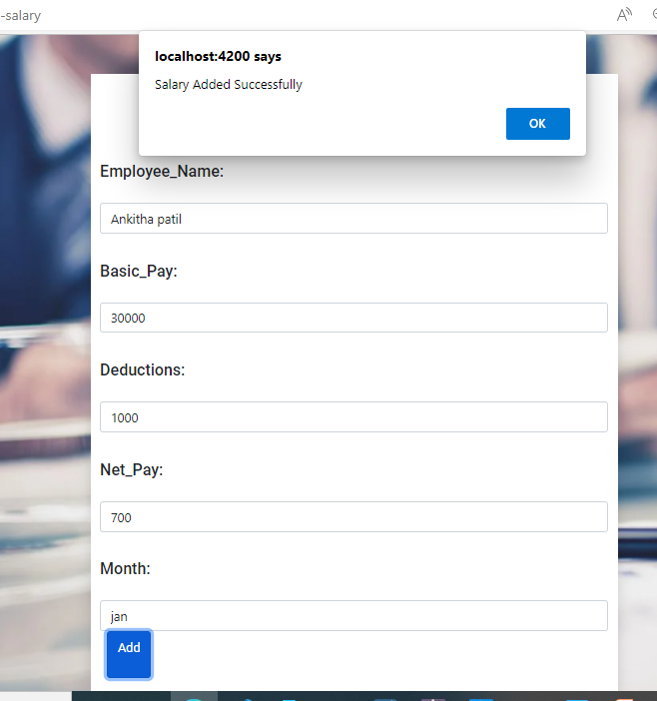
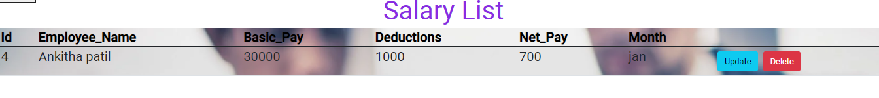
Update Salary

Slide 23
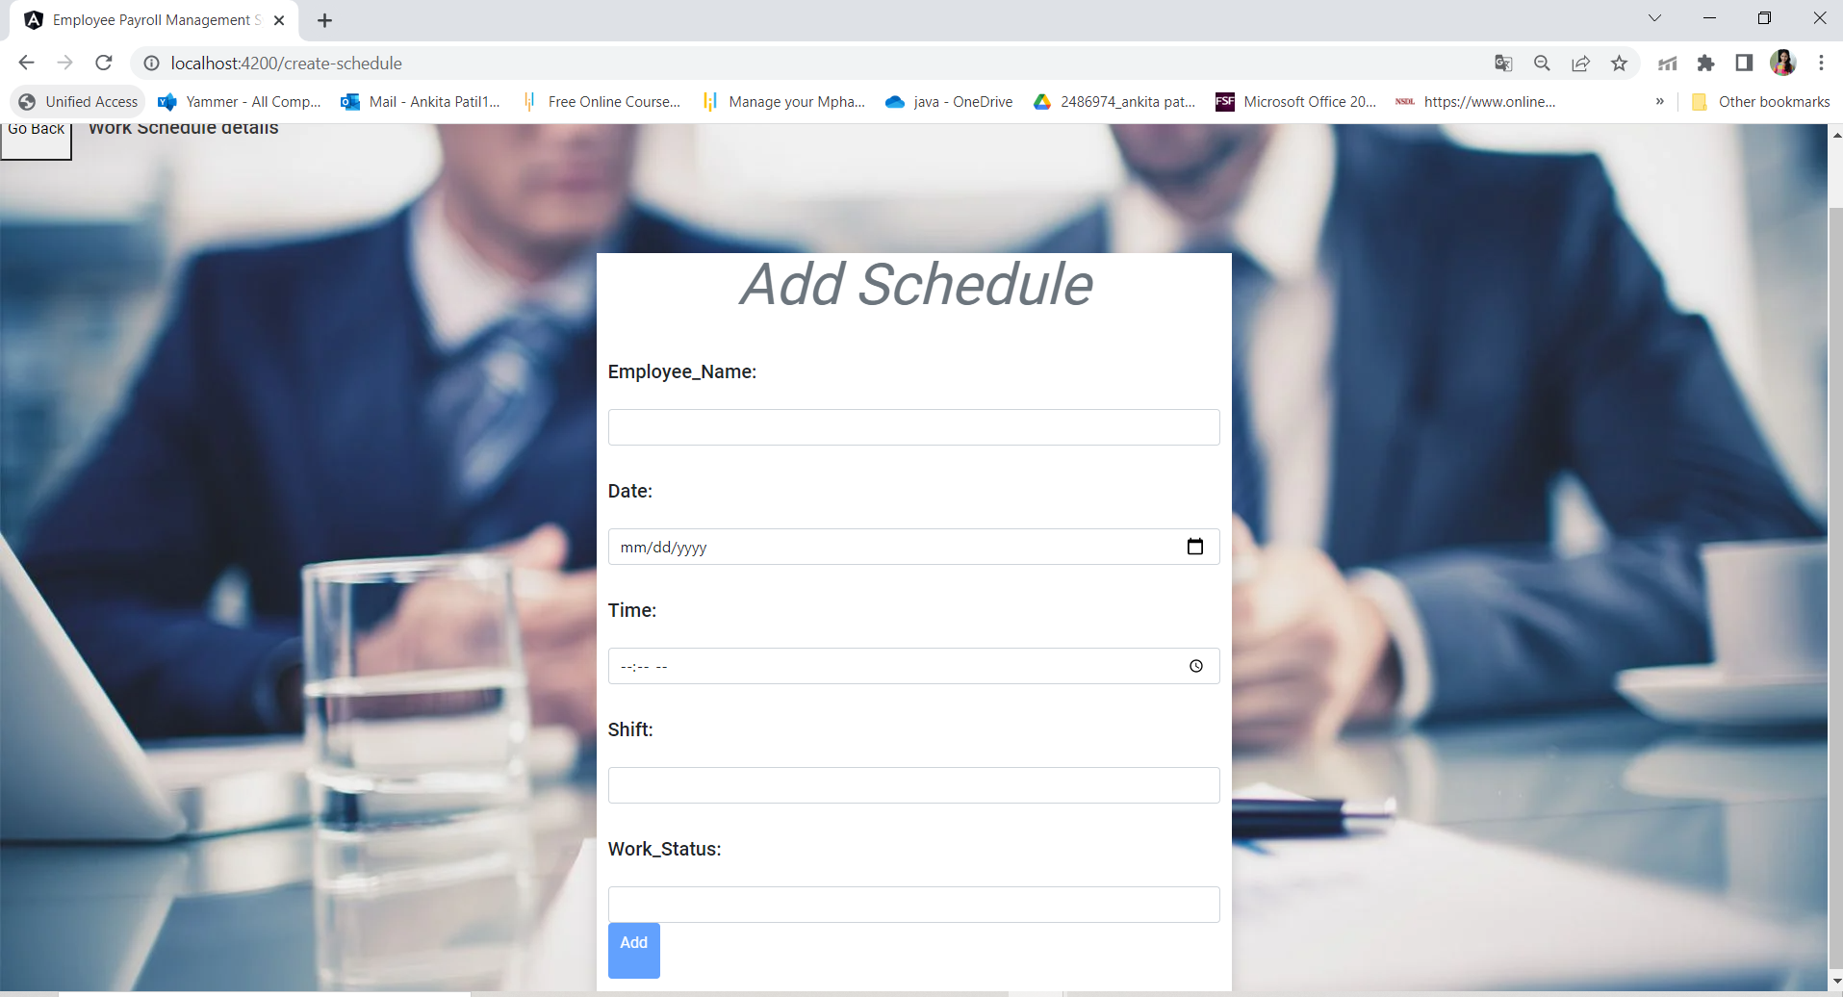
Add Schedule

Slide 24
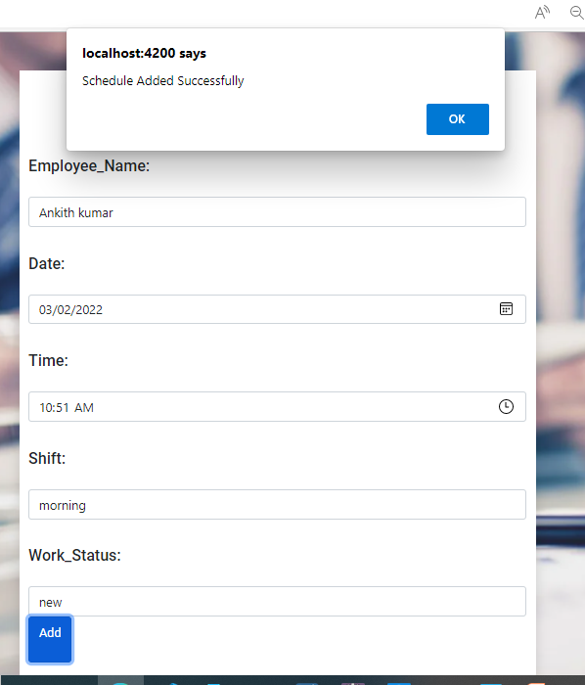
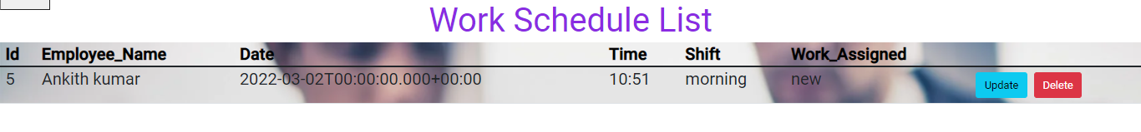
Update Schedule

Slide 25
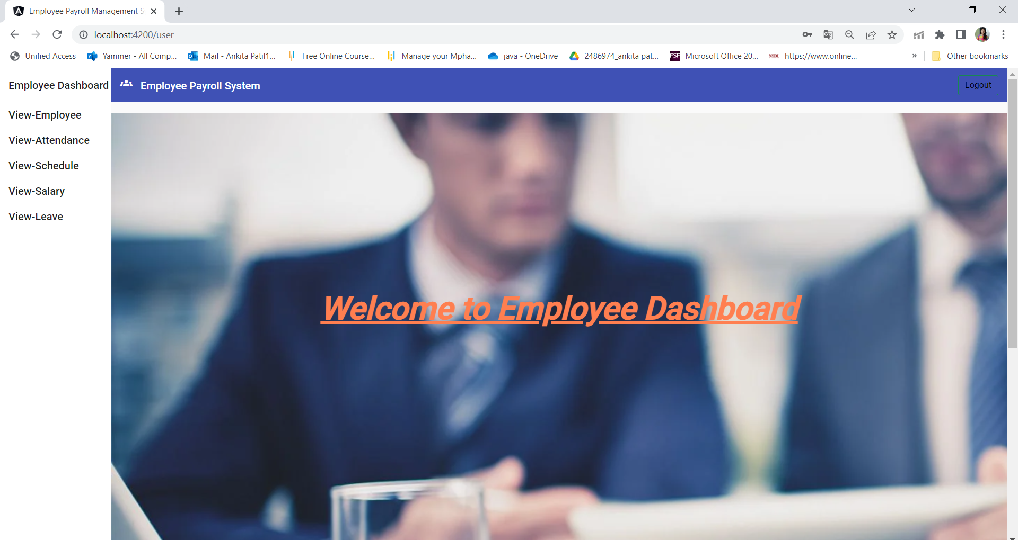
Employee Dashboard

Slide 26
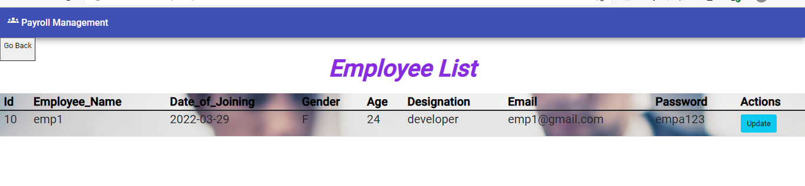
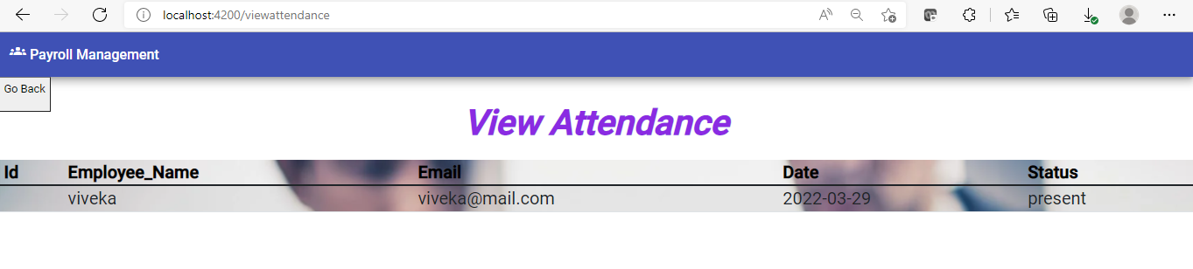

Slide 27
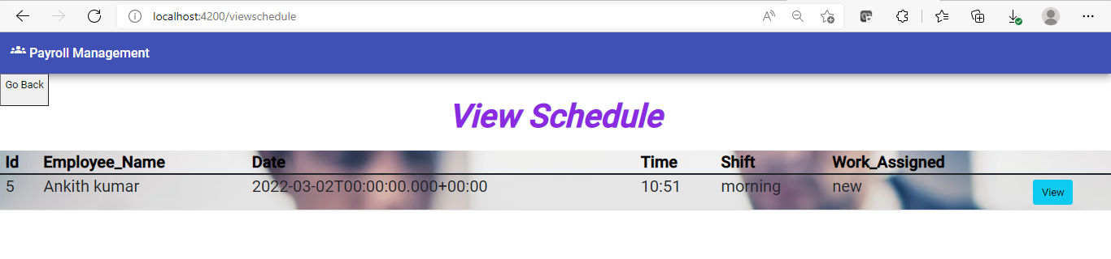
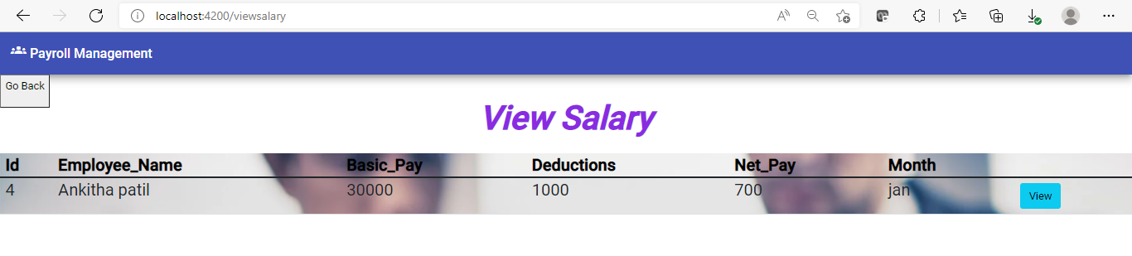

Slide 28
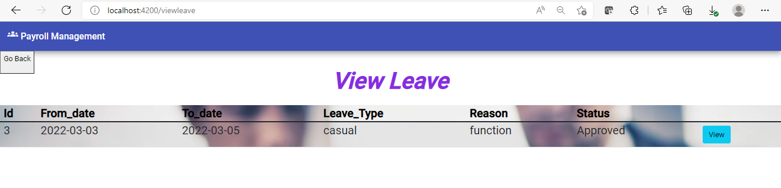

Slide 29
ADVANTAGES
Helps the employee easy way to access their data.
Easy way of login and update the profile.
The information related to employee can be added and removed easily.
Reduce the burden of compliance
Store the end-to-end data of the employees.

Slide 30
Conclusion
“Employee Payroll Management System” software developed for a company has been designed to achieve maximum efficiency and reduce the time taken to handle the Payroll activity. It is designed to replace an existing manual record system thereby reducing time taken for calculations and for storing data.

Slide 31
